Slide 1
Analyzing Fraudulent Credit Card Transaction
CCAI 323 – Machine Learning
Final Presentation
Prepared by
Eyad Alghamdi (2240059)
Raed Alghamdi (2240009)
Nawaf Alshehri (2240403)

Slide 2
Introduction

Slide 3
Project Idea
Our project focuses on finance sector, where highly vulnerable to fraudulent activities.
Financial fraud is a growing issue, with global fraud losses reaching $486 billion in 2023.
According to a PwC report (2022), 51% of companies experienced fraud in the past two years.
Our Idea: Create a system that detects whether a transaction was fraud or not, if the transaction was fraudulent estimate how risky it was.
Benefits:
Enhance the security of digital transactions.
Help reduce financial losses for both institutions and consumers.

Slide 4
Things don’t always go according to plan!
Plan A: Anomaly Detection for Credit Card Frauds
Use fraud and normal data to detect frauds
Plan B: Novelty Detection for Credit Card Frauds
Use only normal data to construct boundaries to then filter out frauds.
Plan C: Analyzing Fraudulent Credit Card Transaction
Use a classifier to detect frauds.
Manually label fraud data into three risk categories
Problems:
New idea, instead of manually labelling, can we automate this process?
Problems:
Very poor results on Novelty Detection approach.
Contamination Rate < 0.58%
No domain knowledge
Any wrongdoing will reset the whole process.
Automate plan A? through clustering!
Separate frauds into three risk categories
Heavily focused on how to understand model’s behavior
Can’t move forward with labeling due to poor results
Dataset Size > 1M sample

Slide 5
Literature Review

Slide 6
Literature Review
Study Click to view | Models Used | Dataset Click to view | Approach | Accuracy Performance
Niu et al. (2019)​ | Supervised: XGBoost, RF, SVM, LR, KNN, DT Unsupervised: GAN, RBM, AE, OCSVM | European Credit Card Transactions | Supervised vs. Unsupervised | Supervised: XGB (98.9%), RF (98.8%) Unsupervised: RBM (96.1%), GAN (95.4%)
Bodepudi (2021)​ | Unsupervised: Isolation Forest, LOF, One-Class SVM | European Credit Card Transactions | Unsupervised Anomaly Detection | Isolation Forest (99.74%), LOF (99.65%), OC-SVM (70.09%)
Lakshmi et al. (2018)​ | Supervised: Logistic Regression, Decision Tree, Random Forest | European Credit Card Transactions | Supervised Learning | Random Forest (95.5%), Decision Tree (94.3%), Logistic Regression (90.0%)
Ong et al. | Supervised: K2, TAN, Naive Bayes, Logistics, J48 | Dummy Dataset | Supervised Learning | Preprocessed: TAN (99.7%), J48 (100%), Logistics (100%); Raw: TAN (84.0%), J48 (80.0%)
Maniraj et al (2019) | Unsupervised: Isolation Forest, Local Outlier Factor (LOF) | European Credit Card Transactions | Unsupervised Anomaly Detection | Isolation Forest (99.74%), LOF (99.65%); Precision: Isolation Forest (28-33%), LOF (2-5%)

Slide 7
The Gap
Literature Gap: Current literature lacks a risk category label for fraudulent transactions.
Proposed Solution: Introduce a new risk category label through unsupervised learning techniques.
Purpose of the Risk Category: The label indicates the level of threat posed by fraudulent transactions to the user and the business.
Risk Levels: The risk category is divided into three levels:
Low-risk
Medium-risk
High-risk
Future Use: The risk category label can be used in predictive models for better decision-making in fraud detection.

Slide 8
State of the Art (SOA)

Slide 9
State of the Art (SOA)
Supervised Model – XGBoost
Builds decision trees where each tree corrects the mistakes of the previous one. A technique that improves model performance by adjusting for errors in previous trees.
Strong classifier, with fast processing, and effectively handles imbalanced data, making it a suitable choice for our project.
SOA Replication
A State-of-the-Art performance was found in Kaggle with same dataset and supervised modelling.
The author focused on feature engineering and data preprocessing to get better performance:
Created key features such as transaction time, age, distance to merchant and encoded categorical variables such as job and state using a LabelEncoder.
Removed unnecessary features to enhance model performance (such as trans_id, names, etc…)
XGBoost | F1-Score | Precision | Recall
Author’s | 0.882 | 0.942 | 0.829
Replica | 0.885 | 0.945 | 0.832
Our Approach | 0.900 | 0.963 | 0.845
Better than the current SOA

Slide 10
Project Workflow / Pipeline

Slide 11
Workflow

Slide 12
Dataset

Slide 13
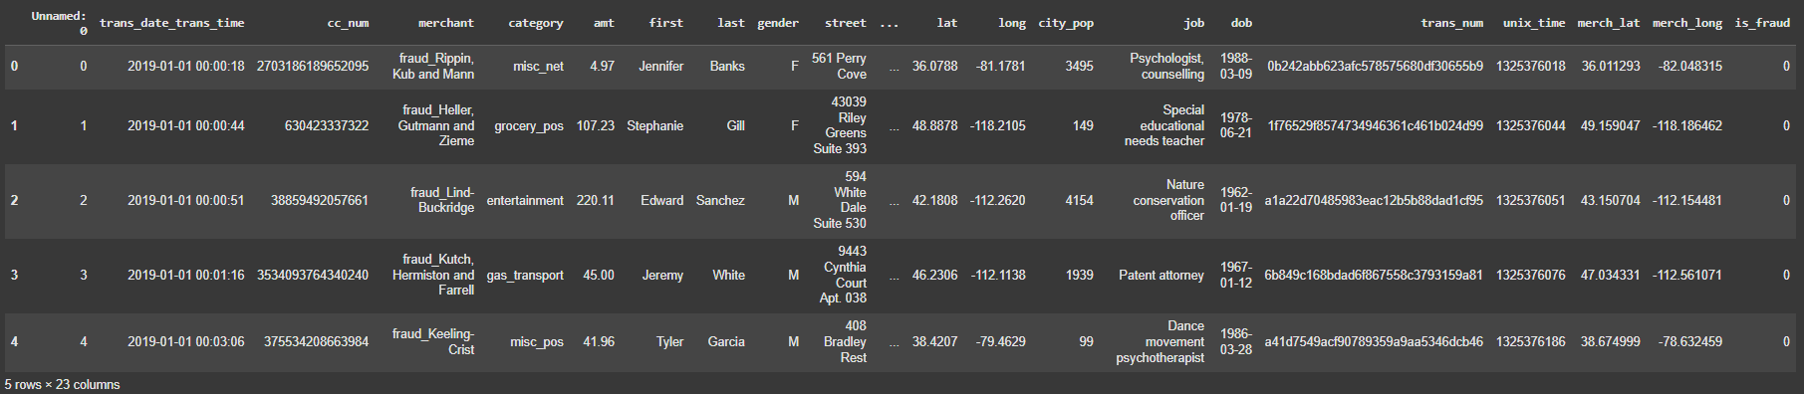
Exploring the Data: Initial overview
Dataset Selection: kartik2112’s Credit Card Transaction Fraud Detection Dataset from Kaggle
Original Dataset size 1,296,675 samples with 33 features
Contamination Rate < 0.58% (#Frauds/#Total)
Mixed attributes (each feature type must be handled accordingly)

Slide 14
Data Exploration

Slide 15
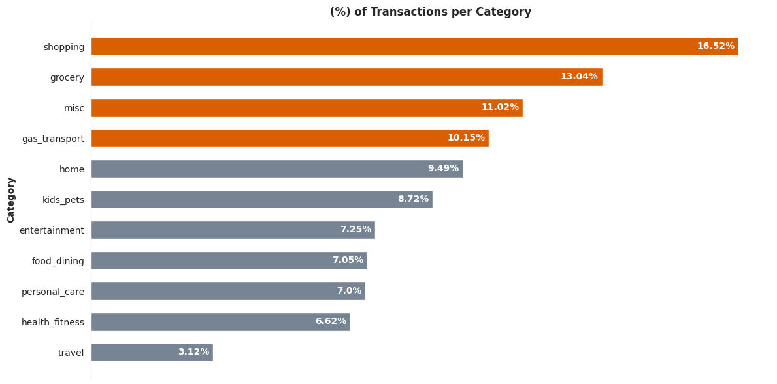
Categorical Feature: Category

Slide 16
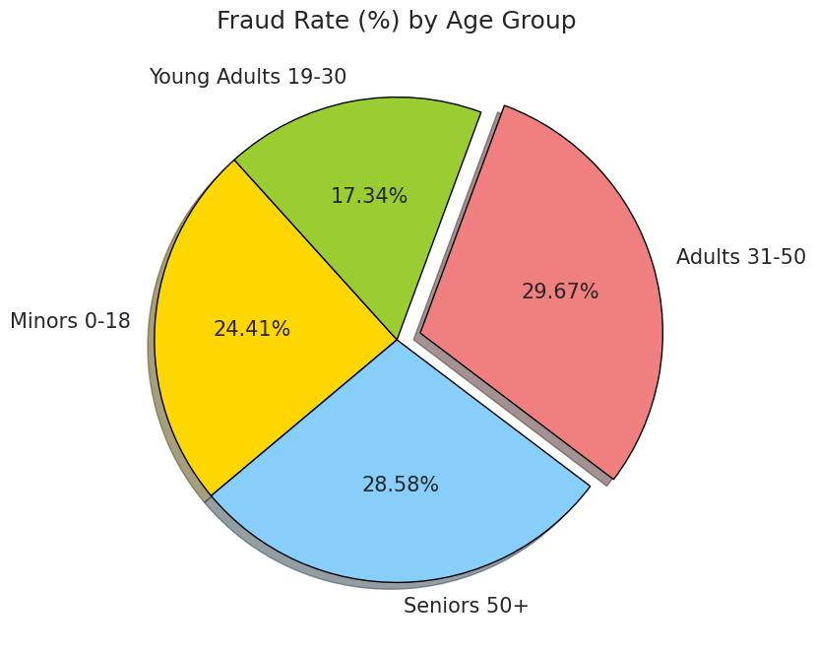
Categorical Feature: Age Group
Feature Engineering: Bin ages to different age-groups

Slide 17
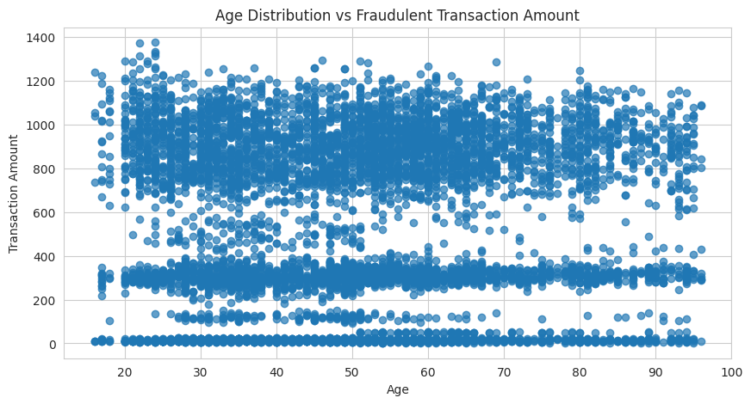
Numerical Features: Age and Amt
Feature Engineering: Extracted age from DOB of CC Holder

Slide 18
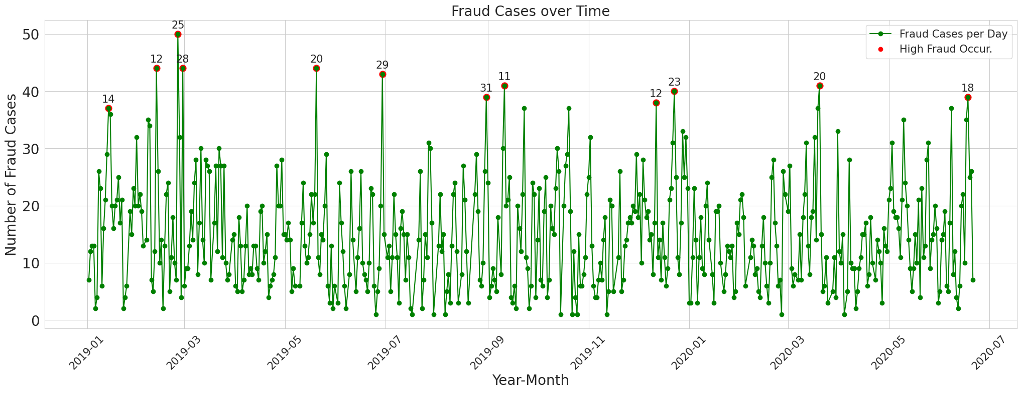
DateTime Feature: trans_date_trans_time
Feature Engineering: Extract year, month, day from trans_date_trans_time

Slide 19
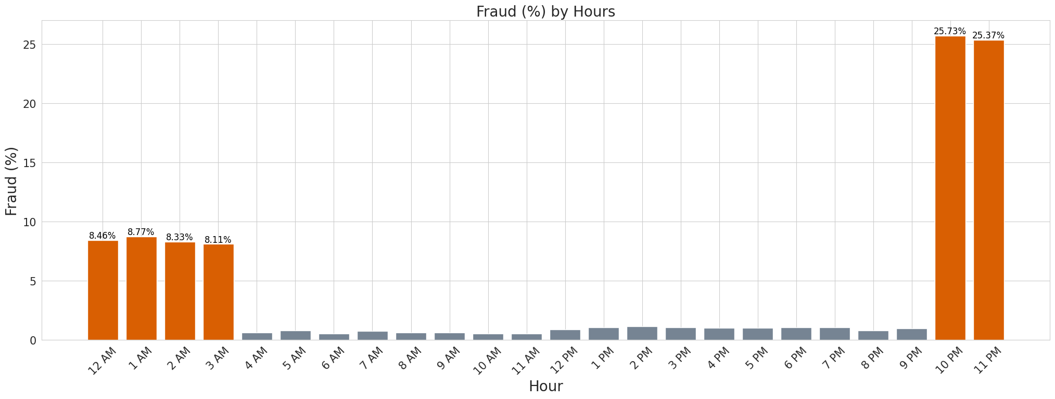
DateTime Feature: trans_date_trans_time
Feature Engineering: Extract hour from trans_date_trans_time

Slide 20
Feature Selection and Data Preprocessing

Slide 21
Feature Selection and Data Preprocessing
Features selected: 'merchant', 'merchant_risk', 'category', 'amt', 'gender', 'city_pop', 'job','age', 'year', 'month', 'day', 'hour', 'minute’, 'is_fraud’
Preprocessing:
Feature ‘category’ (~10 unique value) → One Hot Encoding
Feature ‘gender’ → Label Encoding (0-1)
Feature ‘merchant’ and ‘job’ → Frequency Encoding
Features ‘amt’, ‘city_pop’, ‘age’ → Log-transformed
Then, all numerical features has been normalized to range [0, 1]
Data split: 70% training and 30% testing, with stratified sampling.

Slide 22
Classifier and Interpretation

Slide 23
Classifier
We wanted a strong classifier that has the following properties:
A classifier that is highly interpretable.
A classifier that can handle class imbalance well.
A classifier that is fast and efficient in training.
All these properties pointed to a single classifier, that is the XGBoost!
The base model was trained using the parameters:
n_estimators = 500, learning_rate = 0.2, objective = 'binary:logistics', eval_metric = 'logloss’.

Slide 24

XGBoost Experiments
* scale_pos_weight = #normal/#fraud $≈$ 171.75
We ran three experiments on the model, we used the parameters in the previous slide for all three experiments
The base model shows the most promise in terms of precision and F1-score.
How did all the features impacted on the model performance?
Approach | Precision | Recall | F1-Score
Base Model | 0.97 | 0.84 | 0.90
Random Oversampling | 0.87 | 0.91 | 0.89
Tuning scale_pos_weight | 0.86 | 0.90 | 0.88

Slide 25
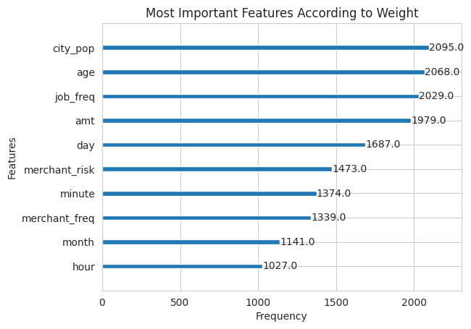
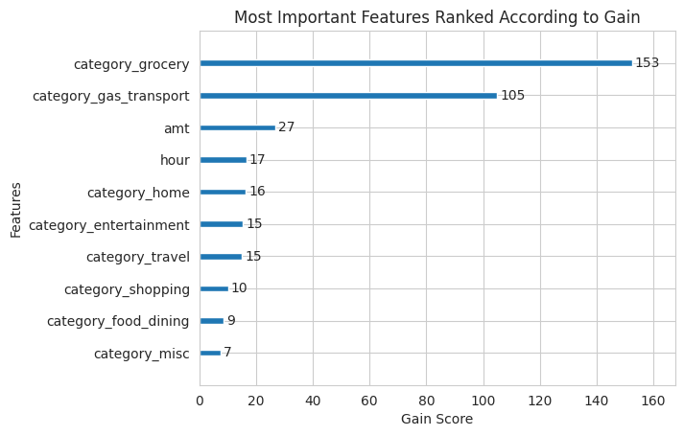
Base XGBoost’s Interpretability
E

Slide 26
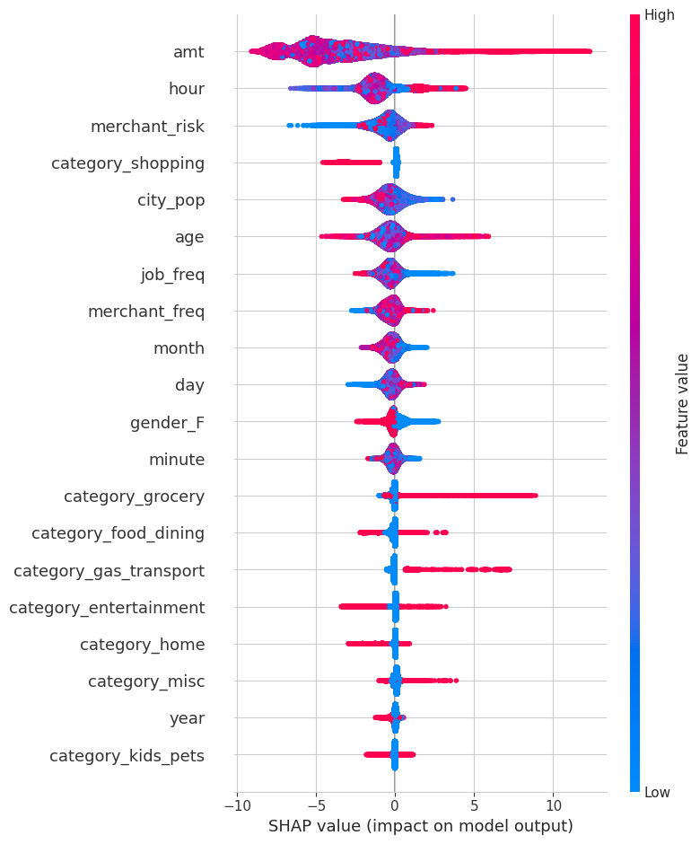
SHAP Analysis Summary Plot
E

Slide 27
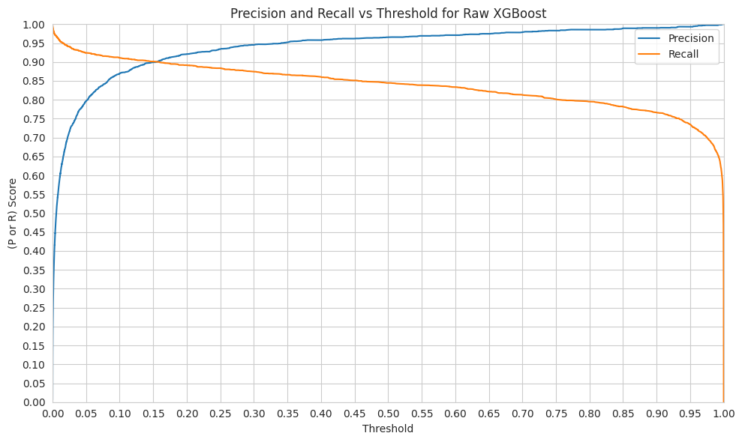
Precision and Recall Tradeoff

Slide 28
Precision and Recall Tradeoff
What threshold yields the best result?
It depends!
Choosing a higher threshold will result in a higher precision but lower recall.
What metric should we prioritize?
Do we want to capture all the frauds? or do we want to reduce manual investigation to reduce time and cost?
How about a balance?
We chose a threshold of T = 0.15; strikes a balance of recall = 0.89, precision = 0.89 and F1 score of 0.89.
Notes:
“Do we want to capture all frauds?”
Yes → Prioritize recall
You're saying: "Missing any fraud is expensive so catch as many as possible, even if some are false alarms."
“Do we want to reduce manual investigation to reduce time and cost?”
Yes → Prioritize precision
You're saying: "We can’t afford to chase too many false alarms so let's only look at cases that are very likely to be fraud."

Slide 29
Clustering and Interpretation

Slide 30
Clustering Risk labels
Approach
Gather all fraud transaction classified by XGBoost then,
Divide them into three risk categories, low, medium, or high.
Selecting risk-related features
Features: ‘amt’, ‘hour’, ‘age’, ‘city_pop’, ‘job_freq’
Clustering algorithm: k-means with k = 3 → Baseline
Silhouette Score: 0.830
Good clusters separations, but how about clusters meaningfulness?

Slide 31
Validating Clusters Result
How do we know that these clustered groups describes different risks levels and not other description?
Realistic exceptions about labels distinctions
Low-risk and high-risk labels should be well separated (distinct)
Medium risk in other hands is a gray-area (fuzzy, or a mush between the two)
We included many analysis techniques to give us a view on the results from different angles,
Histograms
ANOVA
Post-Hoc Tests

Slide 32
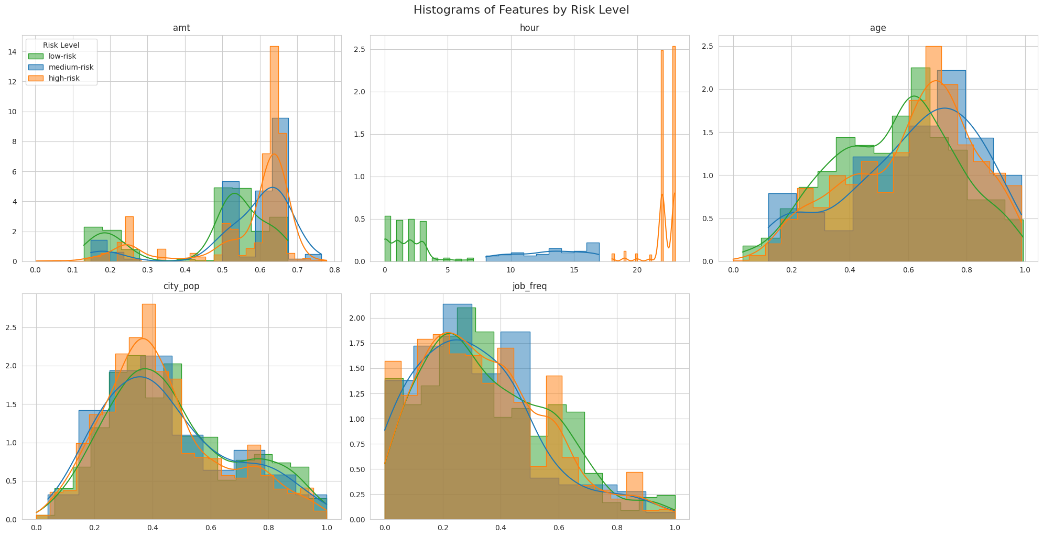
Histogram Analysis

Slide 33
One-way ANOVA Test
Histograms shows the peak and spread of each feature per category.
There are many tests to determine the significant of each feature per risk.
Let the Null Hypothesis be: “There is no significant difference in risk levels (based on the risky-features) between three groups being compared”.
We aim to reject this hypothesis through the ANOVA test, why?
Successfully rejecting this hypothesis, means there are significant differences for this feature in the risk groups.
We used the standard statistical threshold in this test which is 0.05.
If p < 0.05, then the hypothesis is rejected → There are significant differences
If p ≥ 0.05, then we failed to reject the hypothesis →There are no significant differences

Slide 34
One-way ANOVA Test
Feature | P-Value | Interpretation
amt | 0.0000000 | Rejected H₀
hour | 0.0000000 | Rejected H₀
age | 0.0000002 | Rejected H₀
city_pop | 0.0005932 | Rejected H₀
job_freq | 0.0585580 | Failed to reject H₀
Almost all of feature selected are significantly different in risk clusters
except job_freq.
This is all the one-way ANOVA test can give
To further investigate the issue, let’s look at the Post-Hoc Analysis

Slide 35
Post-Hoc Analysis
Following the ANOVA testing, we also aimed to see how significant is the risky-feature in a pair of risk clusters.
This is achievable through the Post-Hoc Tests
In this case, let the Null Hypothesis be: “There is no significant difference in risk levels (based on the features) between two groups being compared”
We also aim to reject this hypothesis
The standard threshold is also set to 0.05
Why also use Post-Hoc, if ANOVA tells you the difference?
ANOVA → answers “is there any difference?”
Post-Hoc → answers “where exactly is the difference?”

Slide 36
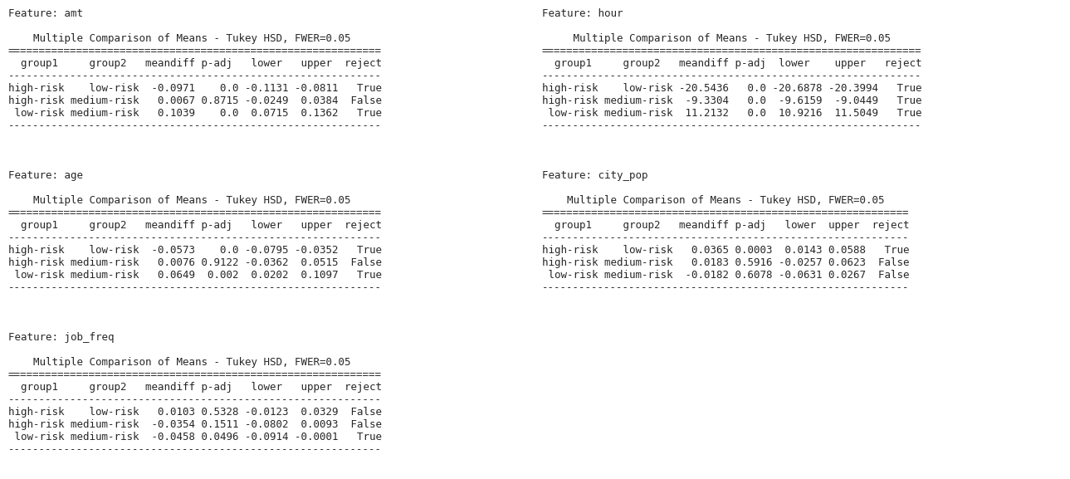
Post-Hoc Analysis

Slide 37
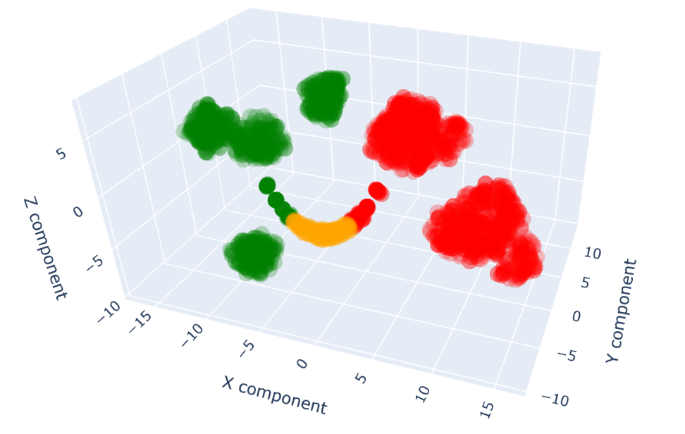
3D Clusters Visualization

Slide 38
Progress Summary & Next Steps

Slide 39
Progress Sum-up
Task | Time (hrs) | Challenges Faced | Member(s)
Literature Review | 6 hrs | - Related studies found only goes to 2021 and before | Raed Alghamdi (Primary) Nawaf Alshehri
SOA Replication | 3 hrs | - | Raed Alghamdi
Data Analysis and Visualization | 4 hrs | - How to convey good analysis that can capture the audience attention | Nawaf Alshehri (Primary) Eyad Alghamdi
Feature Engineering and Selection | 3 hrs | - Creating new features in hope to add more insights - Selecting the valuable features to the models | Nawaf Alshehri (Primary) Eyad Alghamdi
Classifier Implementation and Interpretation | 4 hrs | - Choosing the correct tools to trace the model’s performance on which features were deemed important. | Eyad Alghamdi (Primary) Raed Alghamdi Nawaf Alshehri
Cluster Implementation and Validation | 8 hrs | - Algorithm’s Stochastic Nature - What methods to use for validation | Eyad Alghamdi (Primary)
Documentation | 12 hrs Including mid-sem progress | - | Eyad Alghamdi (Primary) Raed Alghamdi Nawaf Alshehri

Slide 40
Next Steps
Enhancing the performance of the XGBoost if possible by tuning the hyperparameters more.
Introducing new clustering models such as GMM to compare in terms of performance to K-Means
Could give more and better insights
Better feature selection and feature engineering related to risk activities will more likely improve the clustering performance

Slide 41
At last
Thank you for listening!
We appreciate any feedback regarding any stage of the project.

